Slide 1


BANK CUSTOMER CHURN ANALYSIS
TEAM : data_encoders
Created by :
Manuj Kumar Grover
Rajit Anand
Keshav Mahansaria
Uday Srivastava

Slide 2
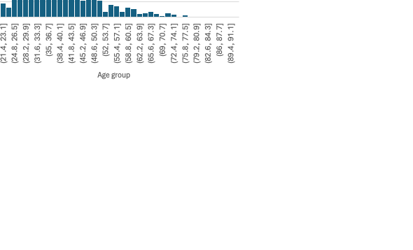
"Loyalty is earned, not given –
understanding your customers is the key to keeping them."
Data Overview
The customer base consists of 10,000 individuals, with 50% from France and 25% each from Spain and Germany.
Over 70% of the customer base falls in the 26-45 age bracket.
The average points earned across all card types are consistent at 606.52 points.
Customers holding Premium cards (Diamond and Platinum) experience churn rates upto 21.07% which is slightly higher than that of Basic cards (Gold and Silver).
A churn rate of 69.92% is observed among credit cardholders.
Inactive customers are more likely to churn, highlighting the need for better engagement strategies.
The average account balance for customers in Germany is 56.4% higher than the overall average balance.
Certain regions display notably higher churn rates, indicating region-specific issues.

Slide 3





Analyzing Demographic Factors
Gender & Churn Rate
Geography & Churn Rate
Age & Churn Rate
Male customers outnumber females by 914, but females have an 8.67% higher churn rate, indicating a need for gender-specific engagement strategies.
Churn rate is significantly higher in Germany (32.44 %) with 1261 inactive customers out of total 2509, suggesting regional dissatisfaction or unmet needs.
Churn is more prevalent among the MiddleAged (35-65) people (29.66%), possibly due to lack of tailored services for that group.

Slide 4

Customer Behavior Factors
Complains vs Exited
Active vs Exited
Average Tenure vs Exited
Churn is more common among customers with shorter tenures, reflecting difficulty in retaining new customers.
Nearly 99.80% of customers who lodged complaints eventually left, showing dissatisfaction with issue resolution.
About 32.5% of customers who submitted complaints were previously active, indicating engagement levels influence retention.

Slide 5
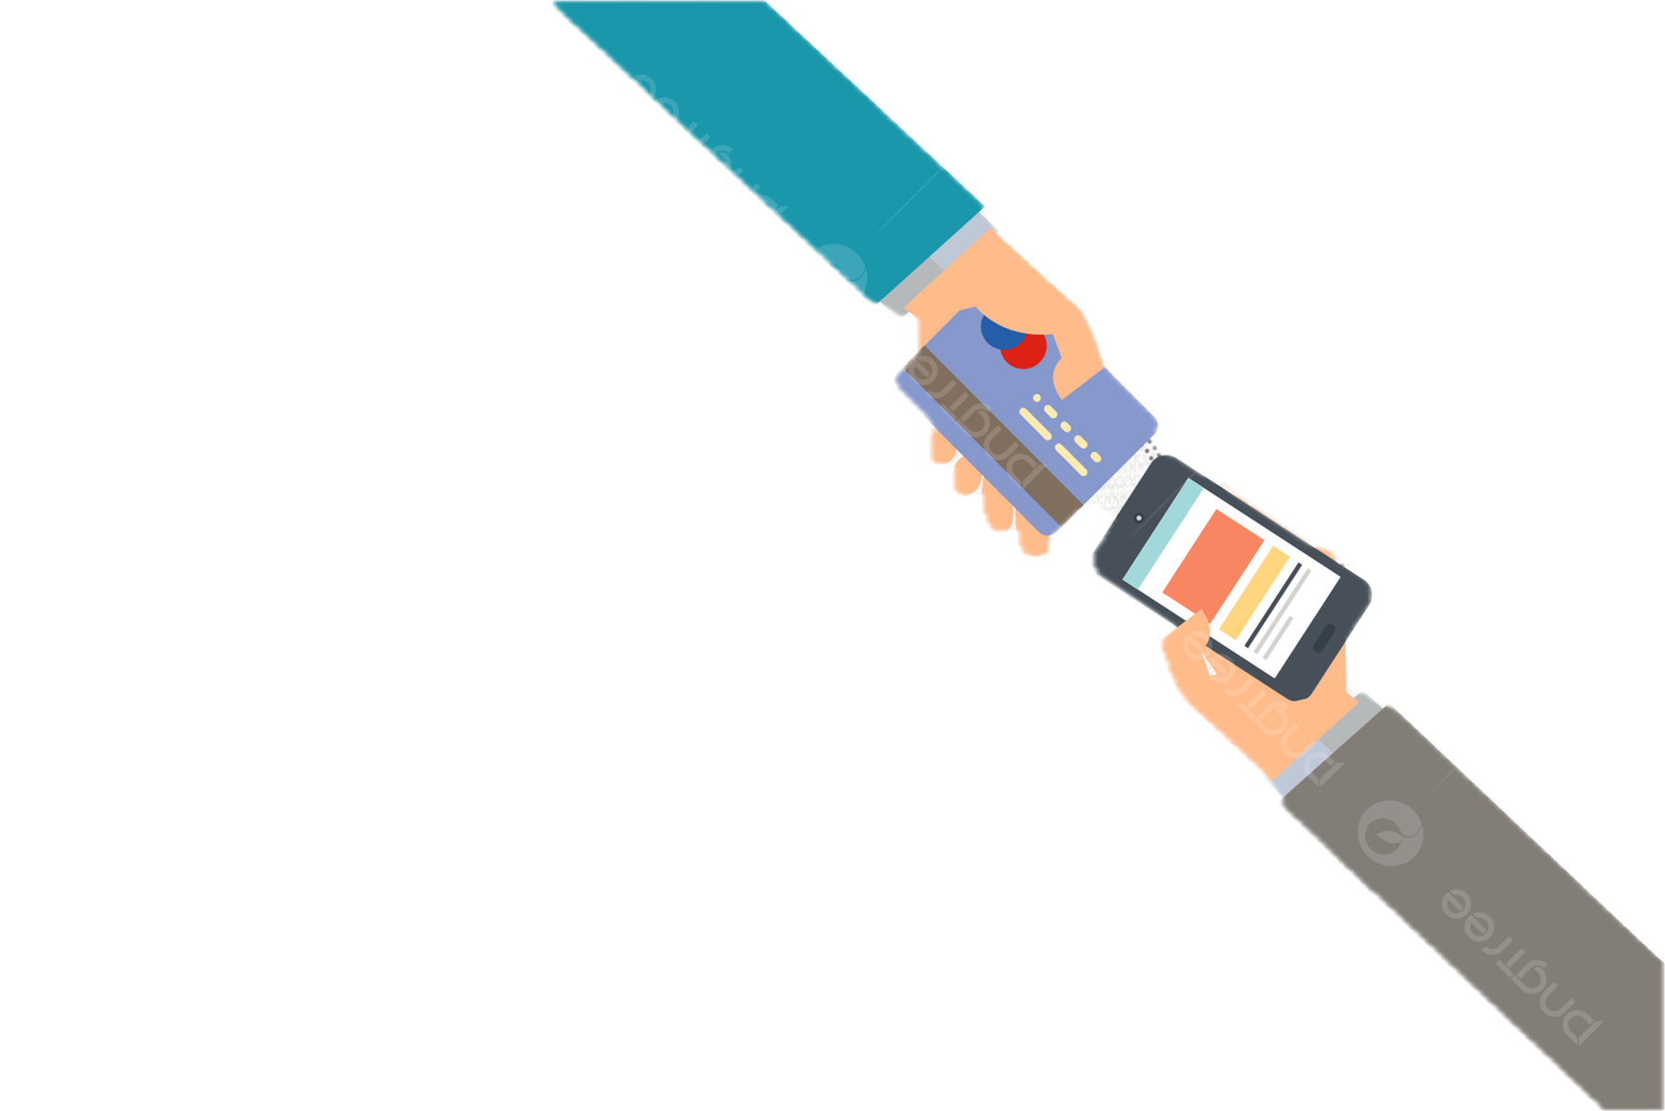

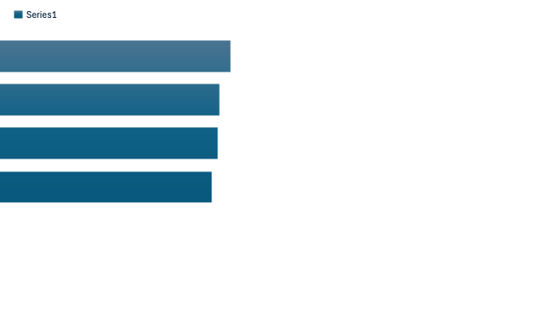
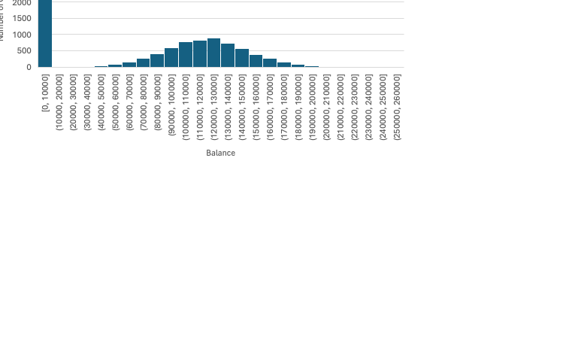
Other Observations
Diamond account holders have the highest churn rate at 21.78% compared to other account types.
Customers owning 3 or 4 products show the highest churn rate.
Customers with two products have balances that are 32% lower than the overall average.
36% of total customers have 0 balance

Slide 6







Reduce Customer Churn & Recommendations
For customers with multiple products (especially 3-4 products), schedule personalized portfolio reviews to streamline their offerings, reduce complexity, and identify potential overlaps or unnecessary fees.
Regularly seek feedback through short surveys, focusing on improvements in service, and product offerings.
Create targeted outreach programs for premium cardholders. Offer tailored incentives, such as exclusive cashback deals or concierge services, to make them feel valued.
Offer periodic financial health checks or advisory sessions to arouse interest and trust among less active clients.
Use demographic data (age, gender, region) to craft specific messages and offers via email, SMS, or app notifications.
For every complaint received, initiate a follow-up within 24 hours with a dedicated representative to address issues.
Use geo-targeted marketing to promote region-specific offers, addressing local customer needs and cultural preferences.
Develop predictive analytics to flag high-risk customers based on behavior (complaints, inactivity, reduced balance). Use these flags to trigger immediate, personalized retention offers.
Offer dedicated financial advisory services for high-balance customers, particularly in Germany, to discuss investment opportunities, wealth management, and personalized banking services.
Create financial literacy sessions and support groups for female customers.
Introduce milestone-based rewards for consistent engagement, such as bonus points for reaching transaction thresholds or anniversaries with the bank.

Slide 7

THANK YOU !

